Slide 1

Procedure 02 – ROBOTC Inputs/Outputs
Basic Output Programming
Basic Input Programming
Lafayette Jefferson High School – Intro to Communications – Mr. White

Slide 2

ROBOTC Output Programming
Ensure Procedure 01 has been followed and all connections are set.
Here is an example of a program for a flashlight that would be typed in the task main() section of the program between the curly braces.
turnLEDOff(green); wait(1); turnLEDOn(green); wait(1); turnLEDOff(green); wait(1); turnLEDOn(green); wait(1); turnLEDOff(green);
Lafayette Jefferson High School – Intro to Communications – Mr. White

Slide 3
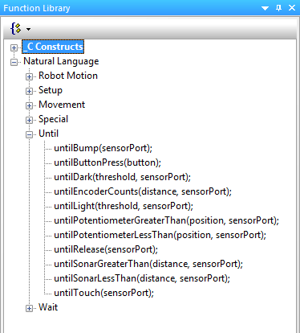
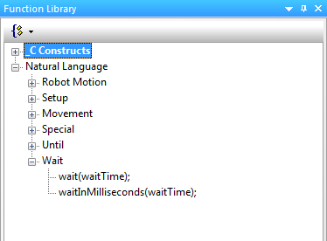
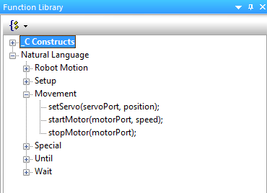
ROBOTC Output Programming Cont’d.
Write a program that performs the following simple behaviors. Use the natural language functions where appropriate as shown below. Add comments at the end of each command line to explain the purpose of each step.
Turn the rightMotor on forward at half speed for 5 seconds.
Stop the motor.
Natural Language – Wait
Natural Language – Movement
Natural Language – Until
Lafayette Jefferson High School – Intro to Communications – Mr. White

Slide 4
ROBOTC Output Programming Cont’d.
Test the program and troubleshoot if needed until the expected behavior has occurred.
Modify the program above to include this simple behavior.
Turn on leftMotor at the same time that rightMotor is turned on.
Test and troubleshoot if needed
Save the program. Show your instructor.
Lafayette Jefferson High School – Intro to Communications – Mr. White

Slide 5
ROBOTC Output Programming Cont’d.
Write a program that performs the following simple behaviors. Use the natural language functions where appropriate as shown below. Add comments at the end of each command line to explain the purpose of each step.
Turn the rightMotor on forward at half speed for 5 seconds, then stop.
Turn the leftMotor on in reverse at three-fourths speed for 2.5 seconds, then stop.
Turn both motors on at full power, and spinning in the same direction, for 7.25 seconds, then stop.
Test and troubleshoot as needed.
Power on the Cortex and Compile and Download the program. If you have any errors, check with your instructor to troubleshoot your program and for sign-off when ready.
Lafayette Jefferson High School – Intro to Communications – Mr. White

Slide 6
ROBOTC Input Programming
Ensure Procedure 01 has been followed and all connections are set.
Here is an example of a program for a motor that is activated/inactivated with a bump switch, which would be typed in the task main() section of the program between the curly braces. Type the program and compile it using the following steps.
untilBump(bumpSwitch); startMotor(rightMotor, 67); wait(5); stopMotor(rightMotor);
Lafayette Jefferson High School – Intro to Communications – Mr. White

Slide 7
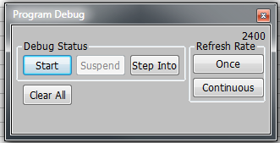
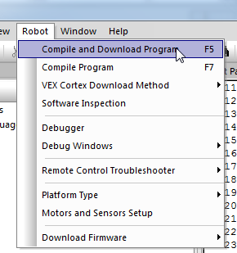
ROBOTC Input Programming Cont’d.
Save the program. Compile and download the program. If you have any errors, check with your instructor to troubleshoot your program.
Press Start to run the program and observe the behaviors.
Lafayette Jefferson High School – Intro to Communications – Mr. White

Slide 8
ROBOTC Input Programming Cont’d.
Write a program that performs the following simple behaviors. Use the natural language functions where appropriate as shown below. Add comments at the end of each command line to explain the purpose of each step.
Wait for the bumper switch to be bumped. Note that bump means that a switch is pressed and released and not simply pressed and held.
Both motors turn on at half power until the sensor is bumped again.
Both motors should then move in reverse at half power for 3.5 seconds.
Both motors will stop.
Use the images from Slide 3 for command help.
Ask your Instructor to check your work.
Lafayette Jefferson High School – Intro to Communications – Mr. White

